Slide 1
Unit 1: Anglo-Saxon Literature

Slide 2
Learning Goals
Students will be able to apply their understanding of ancient concepts like exile, affliction, epic, and purge to modern times
Students will be able to shift their perspectives and empathize with those who are misunderstood

Slide 3
Key terms for unit
Exile:
Epic
Affliction
Purge
Extended Quiz will be at end of unit before exam

Slide 4
Readings
The Seafarer
The Wanderer
Excerpts from Beowulf

Slide 5
Anglo-Saxon Pre-read
Where did this ancient people group come from?

Slide 6
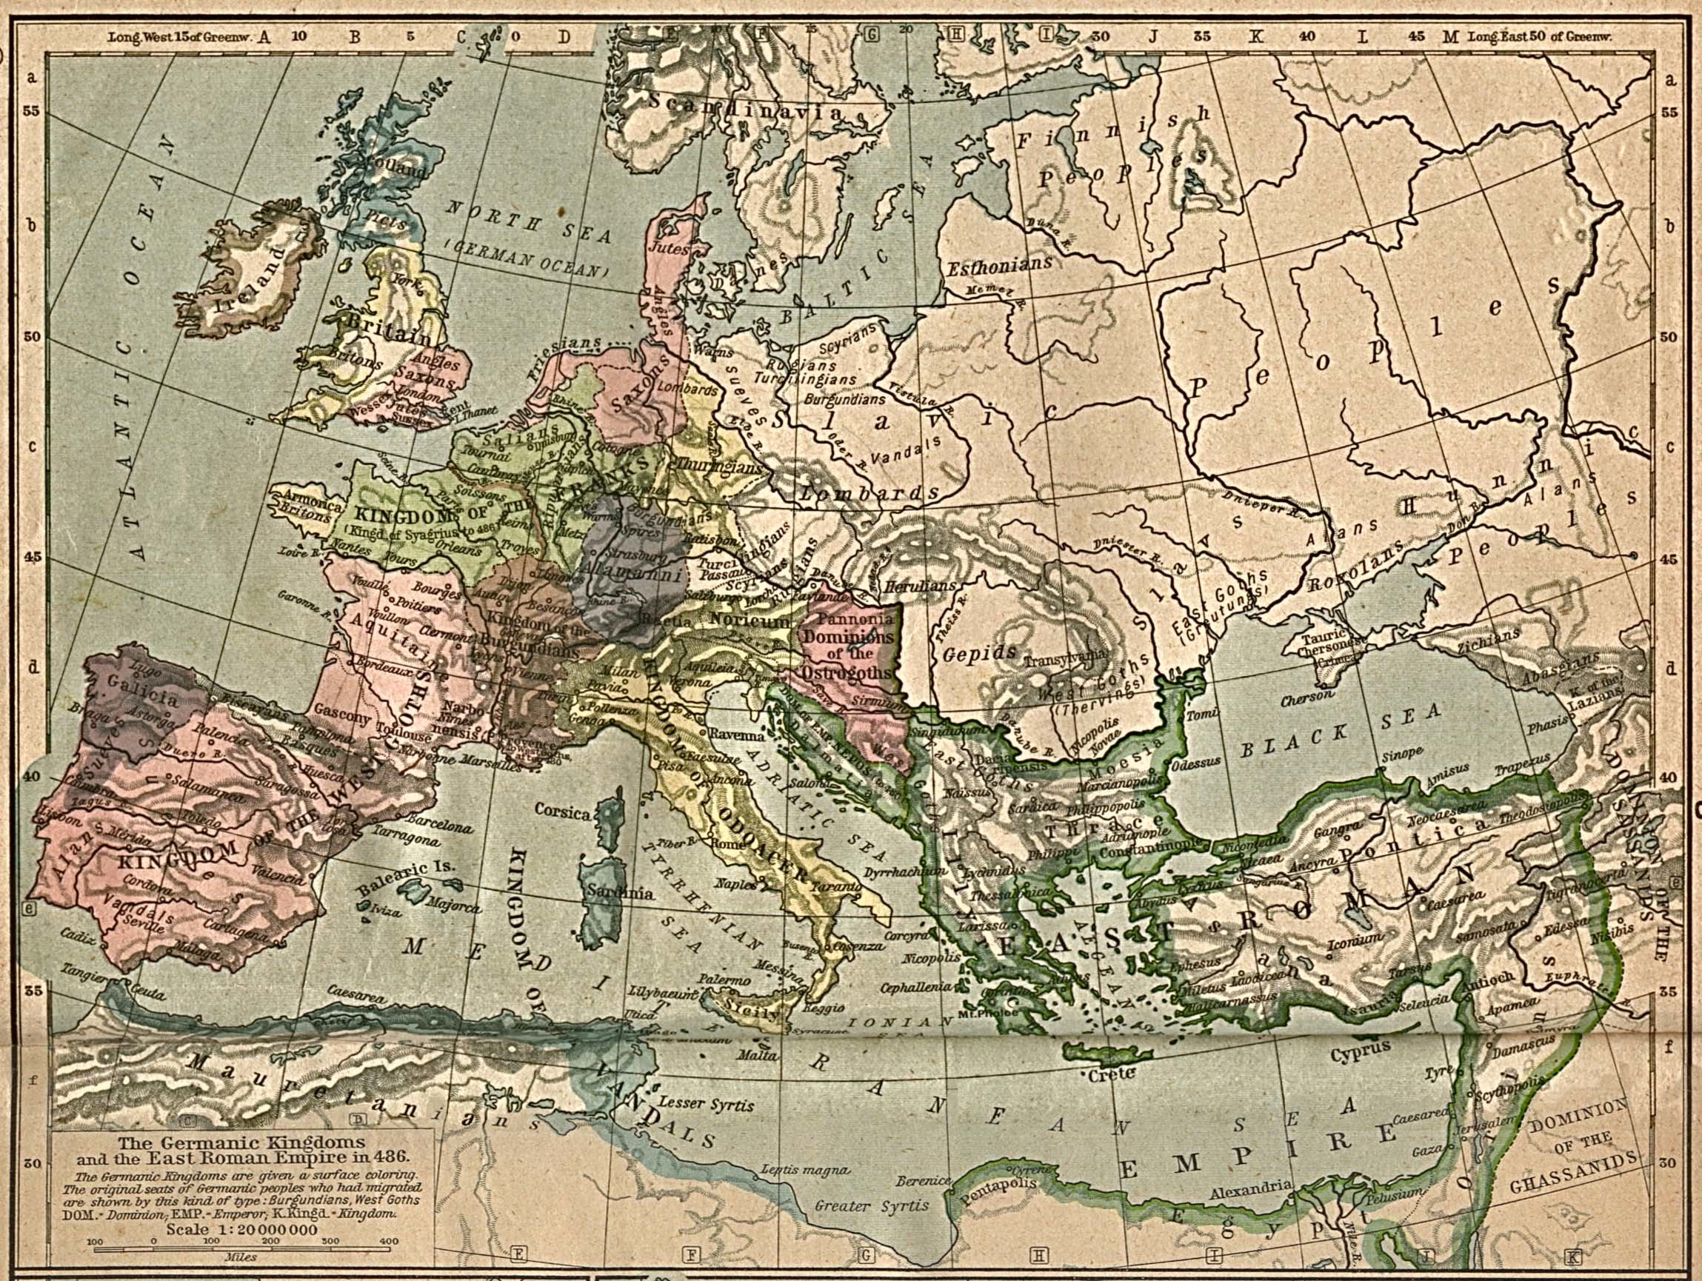
Ancient Europe

Slide 7
Anglo-Saxon background
Between 800-600 BC two groups of Celts (pronounced with hard C) from southern Europe invaded the British Isles
Brythons (Britons) settled on the largest island, Britain
Gaels settled on the second largest island, Ireland
Celts were farmers and hunters
organized by clans (like Braveheart)

Slide 8
Romans
Next conquerors of Britain were the Romans
More sophisticated; developed things like roads and money
55 BC Julius Caesar invaded, true conquest 100 years later
Disciplined Roman legions spread out over the island, making camps that turned into towns
Roman rule lasted 300 years
When Northern European tribes invaded Italy, only then did Roman occupation leave to protect Rome
Last legions left in 407 AD

Slide 9
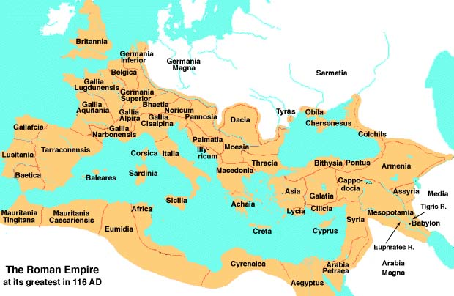
Roman Empire

Slide 10
BC versus AD
What does BC stand for?
Before Christ
What does AD stand for?
Anno Domini (Latin for “in the year of our Lord”)
Secular
BCE – Before Common Era
CE – Common Era

Slide 11
449 AD
By the time the Romans left, new invaders started arriving
Anglo-Saxons from what is now Germany
Germanic Tribes like Germania from Gladiator
Some were deep sea fisherman, others farmers
Gradually they took over England

Slide 12
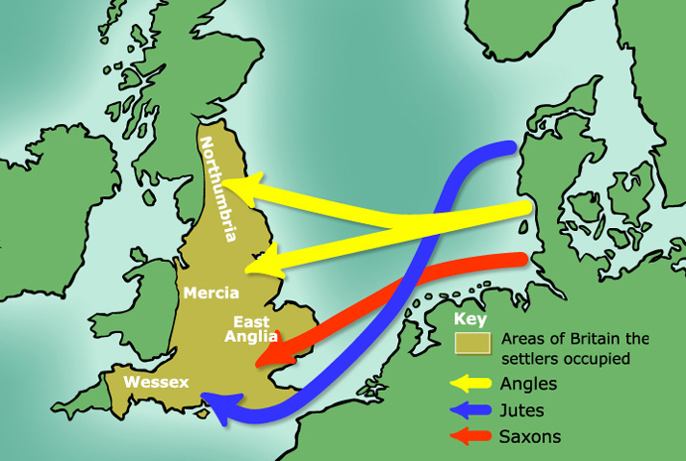
Invasion of British Isles

Slide 13
4th Century influence
Around 400 AD the Romans had accepted Christianity and introduced it to Britain
Because of the vast Roman Empire, Christianity spread throughout Europe
How would this have affected every day life in Europe?

Slide 14
Danish invasion
9th century Norway and Denmark took to the seas when their populations boomed – Vikings
Ruthless invaders
By the middle of the 9th century, most of England had fallen to the Vikings
King Alfred “the Great” resisted the Danes
866 AD formal truce divided England
East and North: Saxons acknowledged Danish rule
South: Danes acknowledged Saxon Rule
King Alfred encouraged learning and education
However, we are focusing on the 5th century

Slide 15
Anglo-Saxon Literature
Started with spoken verse and incantations (old slogans, spells, charms), not books
What other cultures started with oral traditions before books?
Recited poems often at ceremonies or military victory celebrations

Slide 16
Two types of poetry
Heroic Poetry – recounting the achievement of warriors
Beowulf: long heroic poem that tells the story of a great pagan warrior renowned for his courage, strength and dignity; Beowulf is an epic
First such work composed in English so considered national epic poem of England
What language were they writing in before?
Elegiac Poetry – lamenting the death of loved ones and the loss of the past

Slide 17
Latin to English
Before Alfred the Great all important documents were written in Latin
Monks wrote everything in Latin; English, used by commoners, was considered vulgar
Anglo-Saxon Chronicles were started
Historical journals written and compiled in monasteries in Old English

Slide 18
Old English
Started with low Germanic tongue brought by the Angles, Saxons, and Jutes; turned into Anglo-Saxon or Old English
Few words to recognize: bedd, candel, faederm, healp, mann, moder, waeter
Listen to Old English
Readings from Beowulf
And FYI: Shakespeare is NOT Old English!!! His writings are actually modern English

Slide 19
Exile
Banned from one’s country; or forced from one’s home
“Home” to Anglo-Saxons was different than how we think of home
To them, “home” was wherever their king or lord was
Rather than being patriotic to a country, they were loyal to a king
He provided everything for them: food, necessities, protection from invaders
If you were forced to leave home, what are some of the things you would miss most?

Slide 20
Anglo-Saxon Lyrics
Lyric poems expressed thoughts and feelings of a single speaker
The Seafarer and The Wanderer
Oral – they sounded more lyrical, like songs, so they were easier to memorize

Slide 21
“The Seafarer”
Page 15 in book
Content Objective: Students will be able to understand the difference between an earthly exile and a heavenly home
Language Objective: Students will be able to summarize the Seafarer

Slide 22
Seafarer Agenda
Word wall: exile
Bellwork: Imagine you were forced to leave home. List 5 things you would miss dearly.
Read “The Seafarer” on page 15
Stop and paraphrase in notes
I do, we do, you do
Comprehension check page 19

