Slide 1
Beowulf

Slide 2
Beowulf Background
Oral tradition – books, stories, poems passed along by word of mouth
Beowulf takes place in 6th century Scandinavia
Originally told in Old English
When Beowulf was finally written down in the 11th century, it marked the beginning of British Literature

Slide 3
Beowulf
A Geat from a region that is today, southern Sweden
He sets sail from his homeland to try to free Danish King Hrothgar’s great banquet hall, Herot
A monster named Grendel has been ravaging Herot for 12 years
The struggle between Beowulf, a young adventurer eager for fame, and Grendel, a fierce and bloodthirsty foe, is the first of three mortal battles in the long poem aka EPIC

Slide 4
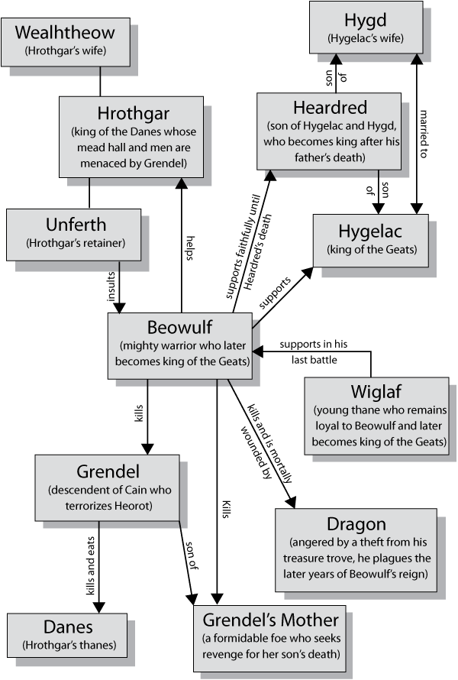
Beowulf Character Chart

Slide 5
Cultural Background
Before Christianity took hold of English (in what century?), it was a Pagan society
Pagans believed
Many gods
Fate
Monsters and creatures
Christians believed
One God
Free Will
Clear distinction between good and evil
When Beowulf was written, England was changing from Pagan to Christian, so Beowulf has both beliefs
Grendel is reminiscent of Pagan monsters
But the battle of Grendel and Beowulf captures the Christian idea of good conquering evil

Slide 6
Beowulf is an…
Epic
What is an epic? (This is one of your vocabulary words this week)
Long narrative poem about the deeds of a hero or legend

Slide 7
Today
We’re reading
“The Wrath of Grendel” pg. 40-43
“The Coming of Beowulf” pg. 43-46
Periodically stopping for comprehension
Make sure to take your own notes as we go along, especially when we stop to talk about something
Character Charts
As we read, jot down character traits, both internal and external, for both Beowulf and Grendel

