Slide 1
Britain after Rome
The Anglo-Saxons

Slide 2
Do Now
What predictions can you make about what hapened to the people and culture of Britain after the collapse of the Roman Empire?

Slide 3
Anglo-Saxons
The Anglo-Saxons were Germanic tribes from Northern Germany. The initial date that is accepted for the first Anglo-Saxon immigration is 449CE. This by invitation of Celtic ruler in the Roman practice of inviting Germanic tribes to new areas so they would defend them against invaders.
In the mid 5th through 6th century CE, they filled the power void in Britain left by the departure of the Romans. These tribes were less “Romanized” than other Germanic tribes and Britain is one of the few places where a Germanic culture completely replaced a Roman one.

Slide 4
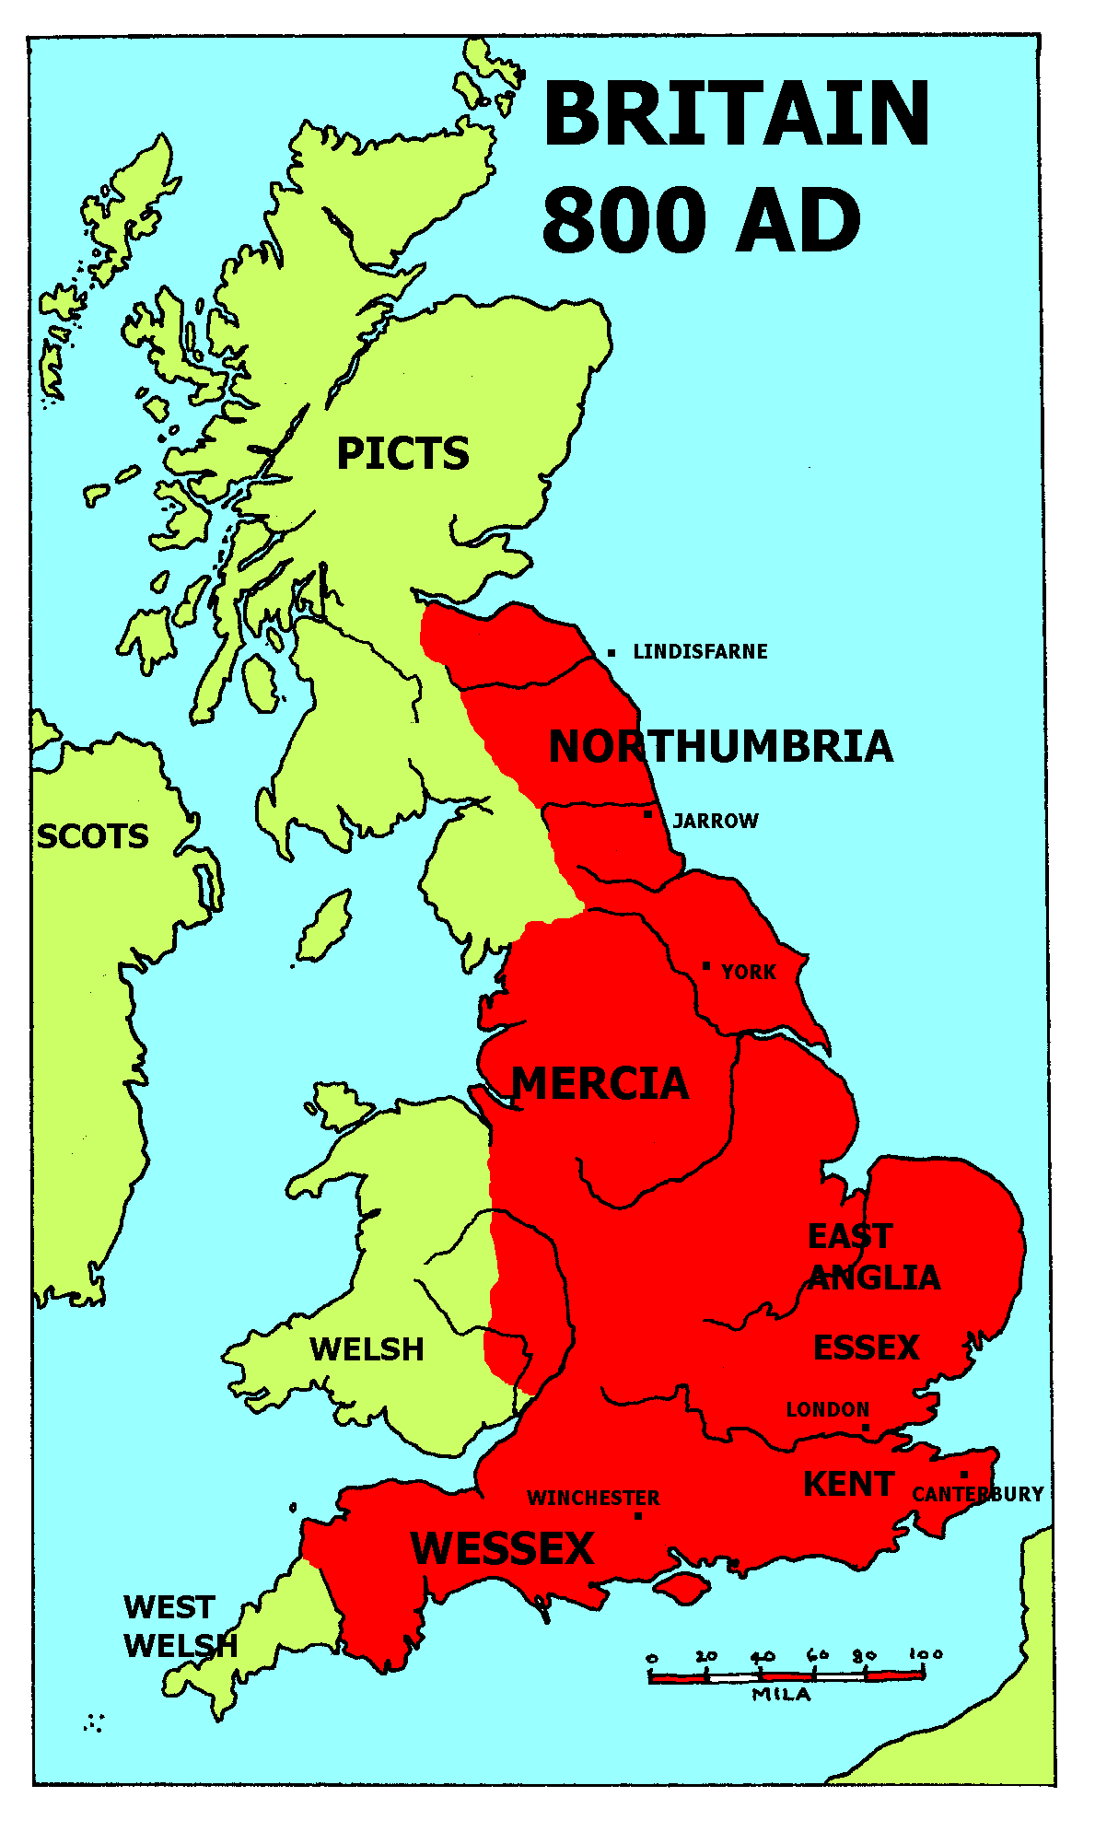
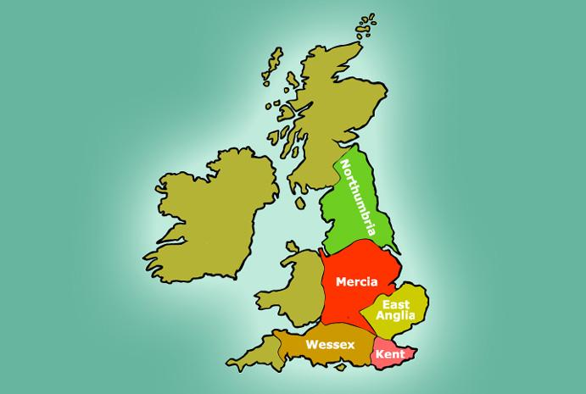
The Anglo-Saxon invasion

Slide 5
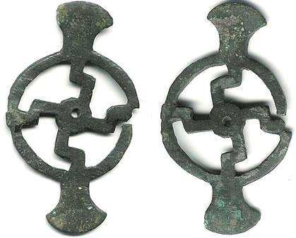
The Anglo-Saxons
The original Anglo-Saxons were pagan, and held a very fatalistic and doom filled world view. All of nature was in fact arrayed against man, and the best man could do was hold the darkness at bay.
They also believed that the
supernatural could be
manipulated by spells
and charms.

Slide 6
English vs the Romance languages
English has mostly Germanic roots, while the “Romance” or more literally “Roman’s” languages have kept their Roman roots more strongly.
Ex: Farmer (english)-Friebauer (german)Agricola (latin)-agriculteur (french)-agricultor (spanish)-Feirmeoir (gaelic)
Love(english)- Liebe (german)-amo (latin)- Amour (french)- amar (spanish)- gra (Gaelic)

Slide 8
Scotland
In Scotland Irish invaders began settling and establishing themselves as an independent culture, which would become the Scots.
Thus both Scotland and Ireland have their common history traced to Ireland.

Slide 9
Christianity after Rome
Christianity in the centuries after the collapse of the Roman Empire supplanted the pagan beliefs and became part of the sense of identity that differentiated the people of Britain from the pagan continent.

Slide 10
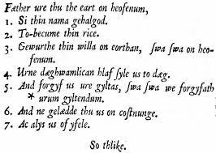
Anglo_Saxon Christian writing

Slide 11
Pelagius
Pelagius was cleric who promoted the idea that salvation could only be obtained by man denying his nature and striving to be perfect, or more in the image of God. He argued God requires perfection, and man must strive on his own to achieve it. He also argued the idea of salvation without the denial of self was promoting moral laxity.
He was denounced as a heretic, but the idea of personal responsibility for one’s salvation or achievement became a part of British cultural fiber.

Slide 12
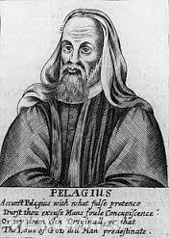
Pelagius
While discredited by the
church, his ideas persisted
longest in Britain and Ireland.

Slide 13
Patricius
What do you know about Patricius, and why does it matter to Americans?

Slide 14
A Second Gaelic Holiday hint….

Slide 15
Patricius
Patricius was a British Roman, a son of priests. He was kidnapped as a youth and sold into slavery in Ireland. He underwent a deep spiritual awakening, and gained his freedom. However, he returned to Ireland after religious training and helped establish the Irish Christian community.

Slide 16
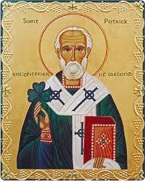
Patricius
The Shamrock is believed
to be the tool that
Patricius used to explain
the trinity of God to the
Irish.

Slide 17
Amalgamation of the Anglo Saxons
Over time the initial differences between the native Bretons (as they were called) and the Anglo-Saxons faded and they were combined in the sense that the whole of Britain became more of a warrior culture, and Christianity rising to be the religion of the British Isles.

Slide 18
Impact of the Anglo-Saxons
The Anglo-Saxon domination of the lowland part of Britain reshaped the identity of the people and distinguished from those on the continent.
What two factors distinguished the British from the people in continental Europe, and why are they significant in the developing British Identity?

