Slide 1
The Canterbury Tales
Pre-Read Notes

Slide 2
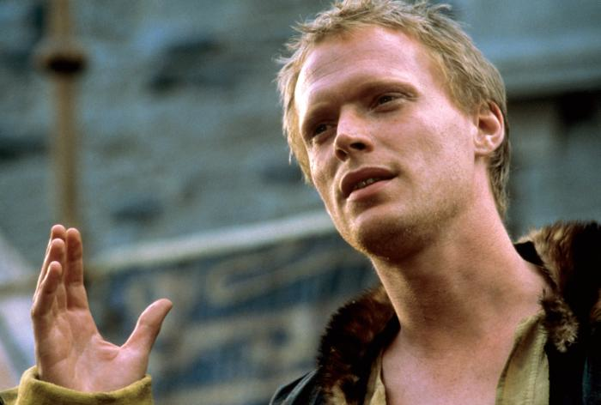
Geoffrey Chaucer
14th Century England
First writer to use English in a major literary work
As portrayed in “A Knight’s Tale”

Slide 3
About the tales…
Frame tale: larger story made up of smaller stories
Rather than epic heroes, Chaucer used real people
Wrote for the commoners, the every day person
That’s why he wrote in English and not in French or Latin
Pilgrimage: a long journey to someplace well-known or respected
People would band together for safety
Takes place on a pilgrimage to Canterbury to visit the shrine of St. Thomas Becket at Canterbury Cathedral. Pilgrims are traveling together. The host of the group suggests they play a story telling game. Whoever tells the best story wins a prize.

Slide 4
Social Commentary
The act of expressing an opinion on the nature of society by rhetorical means; commenting on society
Can you think of examples?
Sermons
Books
Animal Farm
To Kill a Mockingbird
Documentaries
Blogs
Talk shows
Newspaper Editorials

Slide 5
Figurative Language Review
Language not meant to be interpreted _______________.
Irony: expressing meaning through the use of opposites
Types: sarcasm
Situational irony: readers expect one thing but get surprised by its opposite
Metaphor: direct comparison saying one thing is another
Example?

Slide 6
Satire
the use of humor, irony, exaggeration, or ridicule to expose and criticize people's stupidity or vices
Morals, right or wrong, or mild to get a laugh or make a point
Jonathan Swift, “A Modest Proposal”
Satirical hyperbole

Slide 7
“A Modest Proposal”
Read it silently to yourself
See if you can figure out what it’s about
When/if you do…say “yesssss” emphasizing the “s”
I don’t know why. It sounded funny, either that or pat your head and rub your belly. Up to you.

Slide 8
Characterization
The act of creating and developing the personality of a character
Direct detail: statements made about the character
Ex: The knight was chivalrous, truthful and honorable
Indirect detail: when the character’s personality is revealed through his or her actions, thoughts and words
Ex: The knight was not gaily dressed.
In this sense, the indirect detail implies he is modest and humble because he is plainly dressed

Slide 9
Memes

Slide 10
What is a meme?
noun
an element of a culture or system of behavior that may be considered to be passed from one individual to another by nongenetic means, esp. imitation.
an image, video, phrase, etc. that is passed electronically from one Internet user to another.

Slide 11
More
DERIVATIVES
memetic |mēˈmetik, mə-|adjective
ORIGIN 1970s: from Greek mimēma ‘that which is imitated,’ on the pattern of gene .
word trends: When the British scientist Richard Dawkins coined the word meme in his 1976 book The Selfish Gene, he wanted a word like gene that conveyed the way in which ideas and behavior spread within society by nongenetic means. Since then, the word has been picked up to describe a piece of information spread by e-mail or via blogs and social networking sites. A meme can be almost anything—a joke, a video clip, a cartoon, a news story—and can also evolve as it spreads, with users editing the content or adding comments. Common collocates in the Oxford English Corpus are spread, pass, and transmit: as with the Internet sense of viral, meme uses the metaphor of disease and infection.

Slide 12
Examples

Slide 13
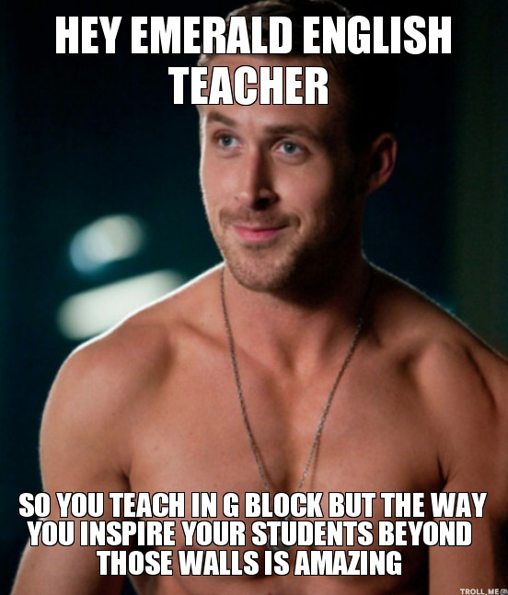

Slide 14
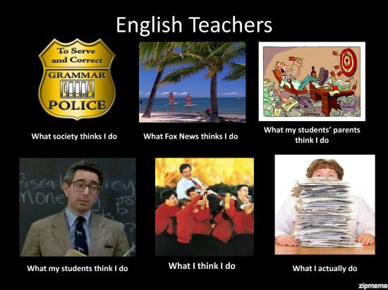
More

Slide 15
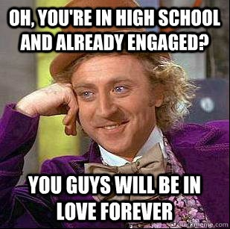

Slide 16
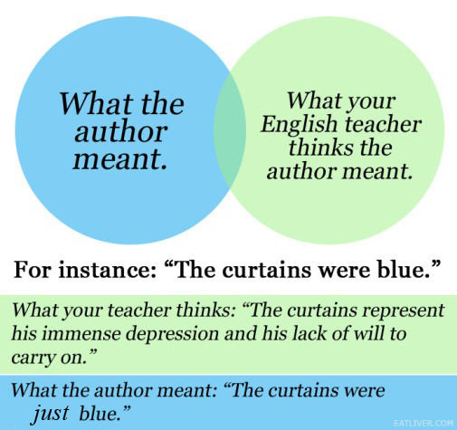

Slide 17
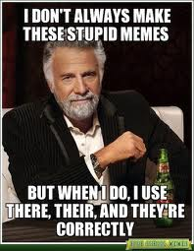

Slide 18
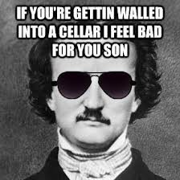

Slide 19
Assignment
Read first paragraph of prologue together
In pairs, pick pilgrim
Read specific pilgrim’s section
Note: Chaucer’s tales are full of social commentary. He used humorous figurative language to reveal his true feelings about each pilgrim and the ironies about who they were and who they were supposed to be.
Figure out what was wrong with each pilgrim
Do they not behave as they are supposed to? According to their job or title?

Slide 20
Continued
Create a meme that points out your pilgrim’s flaws and reveals Chaucer’s social commentary
Take a picture (must be one of you dressed up as character)
Come up with your saying
Create on computer (use computers in here if needed)
When done, email to wewritegood4u@gmail.com
For extra credit: create a meme that comments on a teenage societal flaw in a humorous manner

Slide 21
Things to think about
What is the difference between what each character should be and what he or she actually is?
How does Chaucer or the narrator characterize each character? Indirectly? Directly?
How does Chaucer’s characterization reveal his social commentary?
This is a big one!
What do you think Chaucer is trying to convey to the reader?

