Slide 1
Chivalry & Knighthood
The Warrior Code

Slide 2
Full Definition of CHIVALRY
1: mounted men-at-arms
2: archaic
a : martial valor
b : knightly skill
3: gallant or distinguished gentlemen
4: the system, spirit, or customs of medieval knighthood
5: the qualities of the ideal knight : chivalrous conduct

Slide 3
The 10 Commandments of the Code of Chivalry by Leon Gautier
I. Thou shalt believe all that the Church teaches, and shalt observe all its directions.
II. Thou shalt defend the Church.
III. Thou shalt respect all weaknesses, and shalt constitute thyself the defender of them.

Slide 4
IV. Thou shalt love the country in the which thou wast born.
V. Thou shalt not recoil before thine enemy.
VI. Thou shalt make war against the Infidel without cessation, and without mercy.
VII. Thou shalt perform scrupulously thy feudal duties, if they be not contrary to the laws of God.

Slide 5
VIII. Thou shalt never lie, and shall remain faithful to thy pledged word.
IX. Thou shalt be generous, and give largess to everyone.
X. Thou shalt be everywhere and always the champion of the Right and the Good against Injustice and Evil

Slide 6
The Code of Chivalry from the Rifts
• Live to serve King and Country. • Live to defend Crown and Country and all it holds dear. • Live one's life so that it is worthy of respect and honor. • Live for freedom, justice and all that is good. • Never attack an unarmed foe. • Never use a weapon on an opponent not equal to the attack.

Slide 7
• Never attack from behind. • Avoid lying to your fellow man. • Avoid cheating. • Avoid torture. • Obey the law of king, country, and chivalry. • Administer justice. • Protect the innocent. • Exhibit self control. • Show respect to authority. • Respect women. • Exhibit Courage in word and deed. • Defend the weak and innocent.

Slide 8
• Destroy evil in all of its monstrous forms. • Crush the monsters that steal our land and rob our people. • Fight with honor. • Avenge the wronged. Never abandon a friend, ally, or noble cause. • Fight for the ideals of king, country, and chivalry. • Die with valor. • Always keep one's word of honor. • Always maintain one's principles.

Slide 9
• Never betray a confidence or comrade. • Avoid • Exhibit manners. • Be polite and attentive. • Be respectful of host, women, and honor. • Loyalty to country, King, honor, freedom, and the code of chivalry. • Loyalty to one's friends and those who lay their trust in thee.

Slide 10
Personal honor
Honor, honesty, respect, loyalty, morality, duty, generosity, mercy, self-control, perseverance
One also had the responsibility to be more than a warrior, one should have artistic pursuits, such as writing poetry

Slide 11
Martial valor
To be proficient in the use of arms and armor
To fight with honor and a sense of equality and mercy
To never strike from behind or fight weaker foes, and to show mercy when an opponent yields.

Slide 12
Duty
To one’s Lord, King and Country
To the Holy Church and its edicts
To God
To the Code of Chivalry

Slide 13
Chivalry became an all encompassing code, much like Bushido in that it contained codification not only only of behavior in battle, but of self and pursuits outside of combat.
The difference is that chivalry specifically addresses women, and the concept of mercy.

Slide 14
Becoming a knight
Age 9- one who is eligible or chosen becomes a page, whose primary responsibilities include caring for the knight’s horse, polishing his saddle, and all the myriad of menial tasks required

Slide 15
Age 15- generally if a page had performed his duties well, he would become a squire around the age of 15. At this stage he was in charge of the maintenance of the arms and armor of the knight.He also ensured the page(s) had performed their tasks well, and checked the securing of the knight’s saddle. At this point he was allowed to wear padded or leather armor and carry a sword, but only when in the company of his lord.

Slide 16
Age 20-25 If a squire had performed all his tasks, and trained to a level of proficiency in arms, he could become a knight. This involved many tasks including spending a night praying on one’s knees.

Slide 17
Tools of the trade-Armor
Chain mail- Made of interlocking steel rings,invented by the Celts in the 4th cent. BCE, it was used as the primary armor for most knights until the 14th century.
Plate armour- Used by the Greeks and Romans, it was rarely worn by knights until the 14th century as it was too difficult to make.

Slide 18
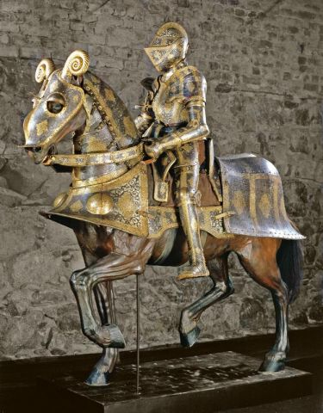
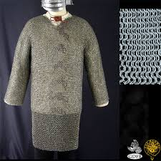

Slide 19
The shield
There were many types of shields used and they varied in size and shape. Most importantly, the shield carried the heraldry of the knight, the coat of arms of his family. Every part of the coat of arms held a meaning, even down to color and direction.

Slide 20
Tools of the trade Weapons
Sword- The knight’s weapon, could be a broadsword, longsword, bastard sword or even two handed.
Axe- Also used, but generally by Germanic knights.
Mace-Generally the backup close fighting weapon, a metal club, sometimes with spikes.

Slide 21
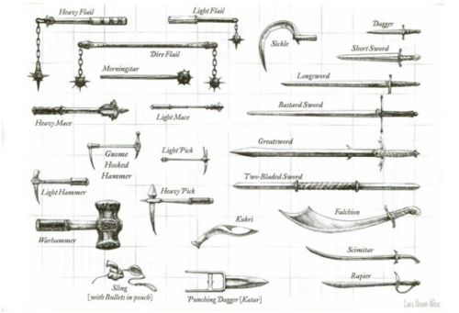

Slide 22
The lance
Combat lance- 3-4m. long with a steel tipped point at the end and a guard to prevent the knight’s hand from sliding up the shaft on impact.
Jousting lance 4m long sometimes hollow, with a cupped or blunt tip, to unseat rather than impale your enemy.

Slide 23
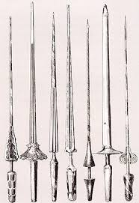

Slide 24
The physics of jousting
Take a 200 pound man, dress him in 60-100 pounds of armor, put that man on a 2,000 pound draft horse, then have the horse run at 25mph. All that energy will be transmitted through a copper cup 2 inches in diameter, delivering 50,000 pounds of force per sqaure inch.
Consider an alligator’s bite, the strongest of any living animal is 3,700 pounds per square inch or dropping a piano from 50 feet onto your head it would generate 10,000 pounds of force per square inch.

Slide 25
https://www.youtube.com/watch?v=Bh5Y_tX-E8U
https://www.youtube.com/watch?v=FLAvtsiduA4

