Slide 1
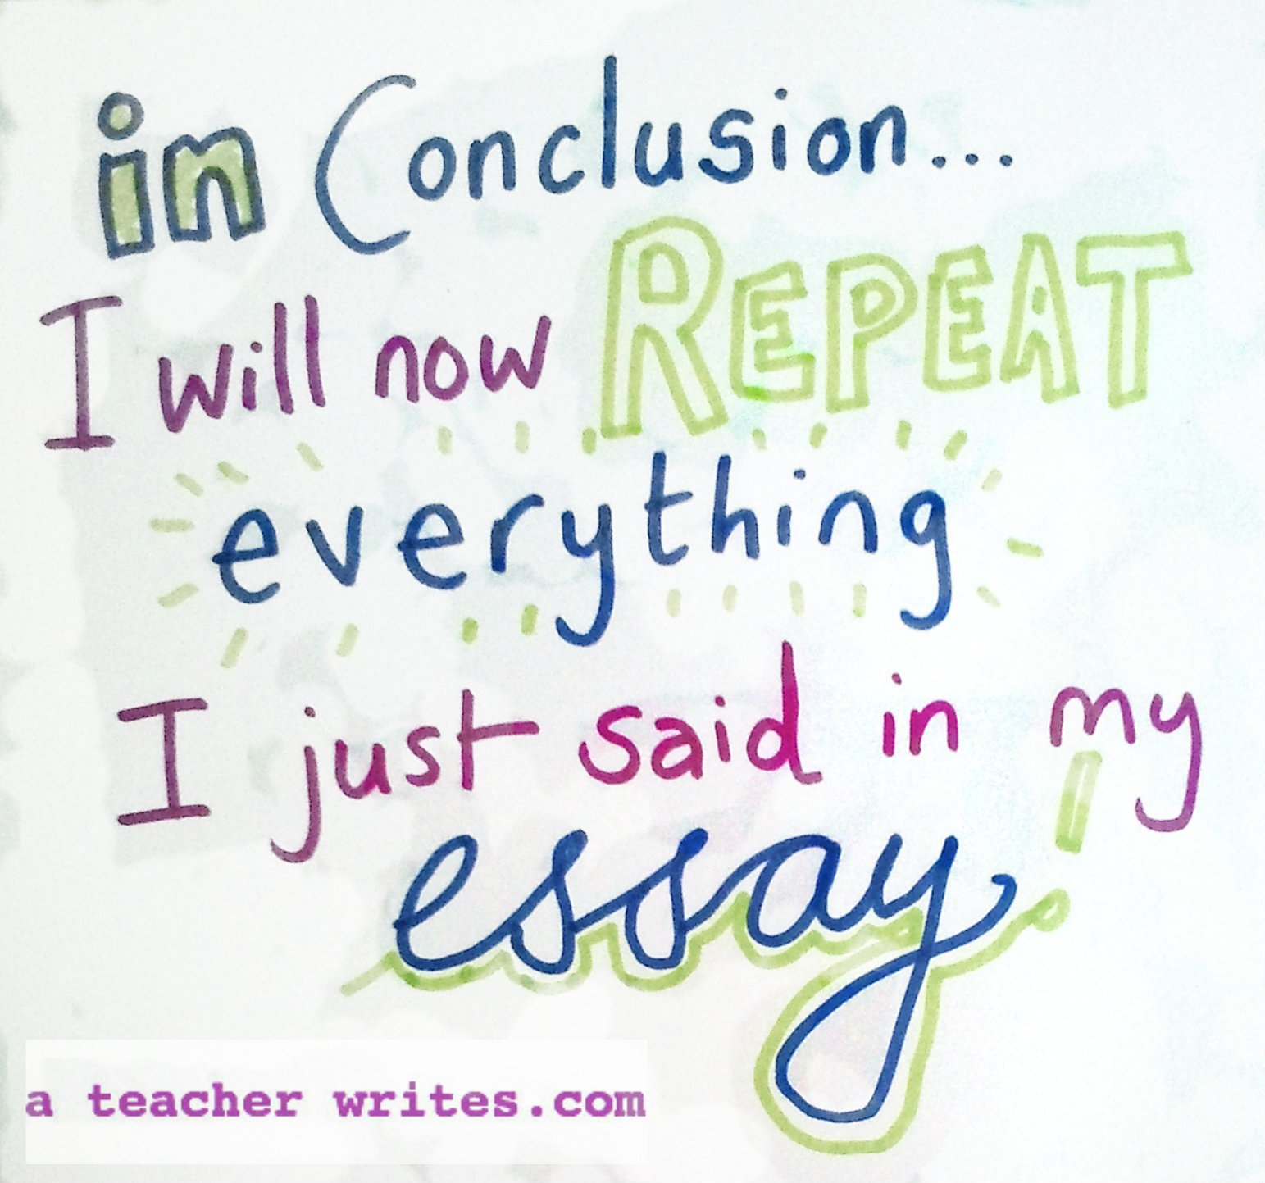

Slide 2
Conclusions: How NOT to drop your reader off a cliff!
Writer’s Workshop

Slide 3
Q: Why is a conclusion important?
A: It’s the last thing your reader sees,
and is therefore what your reader
will remember.
So, leave an impression!

Slide 4
A conclusion should:
stress the importance of the thesis statement
Summarize the sub-points
leave a final impression on the reader

Slide 5
Sample Conclusion
Getting a better job is a goal that I would really like to accomplish in the next few years. Finishing school will take me a long way to meeting this goal. To meet my goal, I will also prepare my résumé and search for jobs. My goal may not be an easy one to achieve, but things that are worth doing are often not easy.

Slide 6
Sample Conclusion
Getting a better job is a goal that I would really like to accomplish in the next few years.
Finishing school will take me a long way to meeting this goal. To meet my goal, I will also prepare my résumé and search for jobs.
My goal may not be an easy one to achieve, but things that are worth doing are often not easy.
restates thesis
summarizes sub-points
interesting final impression

Slide 7
Four Elements
Touch back
Look to the future
Go to the heart
End with a zinger
NEVER introduce new information in your concluding paragraph!

Slide 8
Conclusion Words
in fact to sum up in effect
for these reasons overall thus
as a result of consequently truly
in effect all in all surely
altogether due to
indeed obviously
clearly definitely
in conclusion ultimately

Slide 9
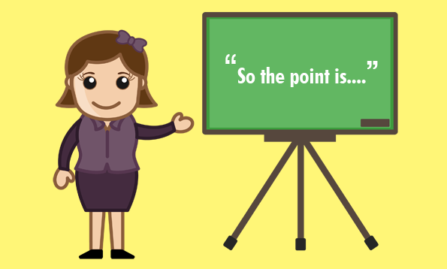
Strategies for an Effective Conclusion

Slide 10
“So what?”
Ask yourself, "So what?" or "Why should anybody care?"
Ponder that question and answer it
Basically, I’m just saying that education was important to Douglass (So what?)
Well, it was important because it was a key to him feeling like a free and equal citizen (Why should anybody care?)
That’s important because plantation owners tried to keep slaves from being educated so that they could maintain control. When Douglass obtained an education, he undermined that control personally.

Slide 11
Return to the Theme
Return to the theme or themes in the introduction
This brings the reader full circle
If you begin by describing a scenario, you can end with the same scenario as proof that your essay is helpful in creating a new understanding
Refer to the introductory paragraph by using key words, or parallel concepts and images that you also used in the introduction

Slide 12
Call to action
Though serving on a jury is not only a civic responsibility but also an interesting experience, many people still view jury duty as a chore that interrupts their jobs and the routine of their daily lives. However, juries are part of America's attempt to be a free and just society. Thus, jury duty challenges us to be interested and responsible citizens.

Slide 13
Sum it up!
As you can see, school uniforms are bad for several reasons. They lower a student’s self-esteem, they promote mindless conformity, and they create the shallow illusion that everything is ok because everyone is in ties and dresses. Schools should be preparing people for the real world where even your boss might be wearing a t-shirt. Let’s stop judging books by their covers and start teaching the things that really matter.

Slide 14
End with an Image
So, Ms. Patrick, imagine our school if we work together to save our Media Center: Mrs. Turner warmly greets students as they enter into this wonderful place where books invite them to cozy up and read. Teachers smile as they see their students discover the joy of reading, and you, Ms. Patrick, meet the grateful eyes of kids who have a bright future—all because you decided to save their beloved Media Center.

Slide 15
Pose more questions
Campaign advertisements should help us understand the candidate's qualifications and positions on the issues. Instead, most tell us what a liar or cheat the opposing candidate is, while they present general images of their candidate as an all-American, God-fearing family man. Do such advertisements contribute to creating an informed electorate or a people who choose political leaders the same way they choose soft drinks and soap?

Slide 16
Look to the future
Without well-qualified teachers, schools are little more than buildings and equipment. If higher-paying careers continue to attract the best and the brightest students, there will not only be a shortage of teachers, but the teachers available may not have the best qualifications. Our youth will suffer. And when youth suffers, the future suffers.

Slide 17
Activity
Pick a method appropriate for your paper
Write a concluding paragraph
Pair & Share with your partner
Peer Review using feedback (A, B, C)
Use separate sheet of paper. Partners sign your name!
Concluding paragraph = 20 pts
Peer Review = 5 pts
Exit Pass

