Slide 1
Introduction to British Literature
A look at Great Britain

Slide 2
Do Now
On Page 1 of your Journals do a KWL of what you know about Great Britain.
Include no less than 3 questions you have about it.
You have 7 minutes

Slide 3
Pair share
With your elbow partner create a list of no less than 5 items that can be used to describe the physical demographics/ characteristics of a country. Both of you should have the list in your journals. You have 3 minutes.
Hint: THINK ALMANAC

Slide 4
Use the following map to identify and label the following on your map:
England
Scotland
Wales
Northern Ireland
Ireland

Slide 5
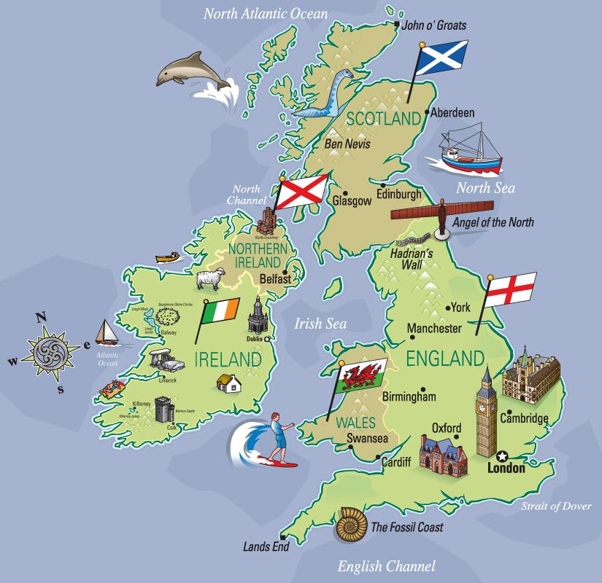

Slide 6
Add the mountains to Britain. You do not need to be perfect, just mark their general location.

Slide 7
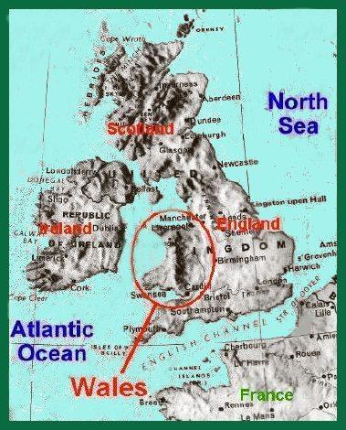
Geography
Great Britain is
mountainous in
the North and
West. It has plains
and forests in the
South and East.

Slide 8
Location in Europe

Slide 9
Size
9th largest island
Almost 81000 sq. mi.
600 mi. N to S
300 mi. E to W
Technically an Archipelago of islands
Tallest peak 4409 ft high (Ben Nevis)

Slide 10
Climate
The Atlantic Ocean and Gulf Stream moderate temperatures in Great Britain. It is generally warmer in winters and cooler in summers than the rest of Europe.

Slide 11
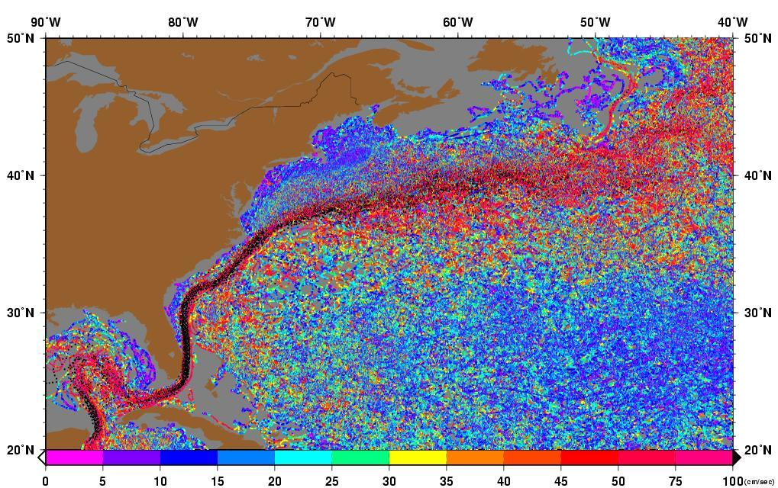
The Gulf Stream

Slide 12
Climate
Rainfall
in Great
Britain is
plentiful
as
compared
to other
parts of
Europe..

Slide 13
Other physical characteristics
Seismic activity is minimal in Great Britain, unlike some other parts of Europe.

Slide 14
Answer
How might being in a location with lots of seismic activity pose problems for people?
Answer in your journal and confer with your square partners.
You have 5 minutes.

Slide 15
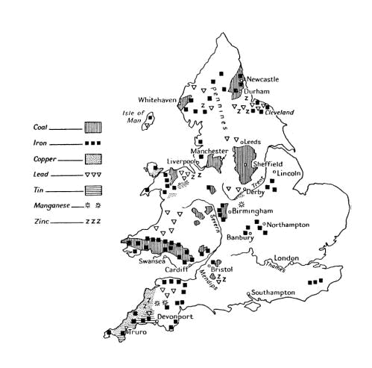
Natural Resources
Great Britain has many minable metals, and was called the Island of Tin at times during the Roman occupation.
Note that there are few large rivers in Great Britain.

Slide 16
Other resources and features
In England there were great Forests, and lots of arable land.
England has many rivers, but only a few are large and deep enough to allow for trade inland. However no point in England, or even the whole of Britain that is more than seventy five miles from the ocean, so rivers are not essential for access to the inland areas.

Slide 17
British industries
Look at the Geography and location of Great Britain and think about what other industries it might have. List them in your journal, and provide a reason why you think this industry might exist.

Slide 18
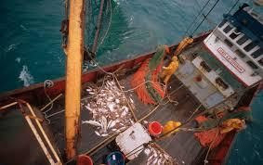
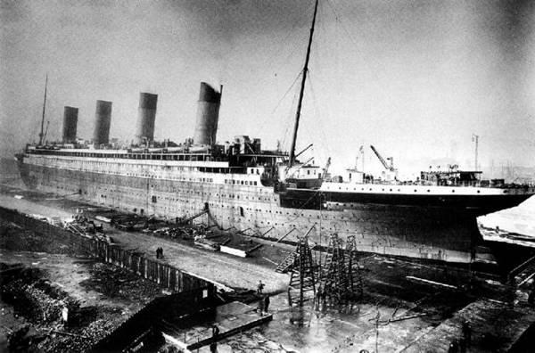
Industries
Fishing
Ship building

Slide 19
One nation, two cultures
Great Britain has been historically a nation divided not by race or religion, but one divided by altitude. There are two types of terrain in Britain, the lowlands, and the highlands, and these have served to divide Britain’s people and culture.
Highlands is a relative term as the highest mountain in all of Great Britain is less than 4500 feet high.

Slide 20
One nation, Two cultures
Highlands
a. Defn- anything over 200 m
b. location: Scotland, Wales, Ireland
c. Pastoral-weather too cold and wet and soil too rocky and chalky for intensive agriculture mostly oats and barley as crops, sheep raising
d. lower population density
Lowlands
a. Defn- anything under 200 m
b. location: England, specifically Southern and Eastern
c. Agricultural- wheat, oats , barley, cattle
d Greater population density

Slide 21
Answer
How are the differences in culture based on the highlands/lowlands example similar to what happened with Polynesians as they crossed the Pacific?
Share with your elbow partner and cme to a consensus on two points to write on the board.

Slide 22
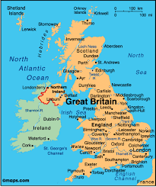
Other nations in Archipelago

Slide 23
Other Populations and Languages
Scotland- (Scottish Gaelic)
Wales-(Welsh)- a derivative of Gaelic
Ireland- (Irish Gaelic)
Cornwall- Cornish Language last spoken in 18th century)

Slide 24
A Second Look

Slide 25
Look at the flags for these countries
England has the cross of St. George
Northern Ireland has the cross of St. Patrick
Scotland has the cross of St. Andrew
However
Wales has the Banner of the Red Wyrm
Republic of Ireland has a tricolor flag with references to its Gaelic tradition, the followers of William of Orange and the peace between them.

Slide 27
In looking at the flags, how do they show any relevance to you here in Hawaii?

Slide 28
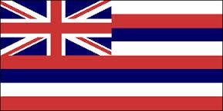
The Union Jack
The United Kingdom’s flag is the Union Jack. It is a combination of the cross of St. George and St. Patrick.
Hawaii has a Union Jack on its flag to reflect the relationship and history Hawaii has with Britain.

Slide 29
A Bundle of Terms
England- term used for ancient SE Britain as well as modern times to refer to United Kingdom
Great Britain- modern term for kingdoms of England, Wales, Scotland, Northern Ireland and other islands in archipelago- first used by King James VI of Scotland after death of Elizabeth I in 1603
United Kingdom- United Kingdom refers to the United Kingdoms of England and Northern Ireland and may include Scotland (modern).

Slide 30
Muddy points
On a half sheet of paper provide:
1 fact you know
2 new facts/words you learned
3 questions you have or items you are mot clear on

Slide 31
Next we will look at the earliest people who inhabited England, and what contributions they made toward establishing a unique British identity and how that shaped our American identity.

