Slide 1
Great Britain’s first inhabitants
The Paleolithic people and the Druids, Gaels, and Gauls.

Slide 2
Do Now:
Identify and explain two common traits of Hawaii and Britain.
Identify and explain 1 difference between Hawaii and Britain.

Slide 3
Paleolithic people
Paleolithic “stone age” Paleo- ancient lithic- stone
Britain has been inhabited as long ago as 300,000 years ago. However, these initial settlers left 50,000 years ago at the end of the last ice age.
A land bridge existed between Britain and the European continent until 11,000- 9,000 years ago.

Slide 4
Paleolithic people
These people were hunter-gatherers, and left few traces of their habitations, and any traces show no unique “British” identity.
They did however leave many megalithic circles, or henges.
The henges were built between 2600 and 2000 BCE.
These marked various astronomical events, but were also marked births and deaths.
There were many kinds of henges, in many locations throughout England.
There are several stonehenges, and even woodhenges throughout Southeastern England. However, there are no strawhenges. Any idea why?

Slide 5
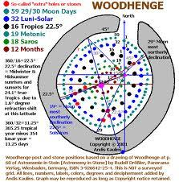
Woodhenge

Slide 6
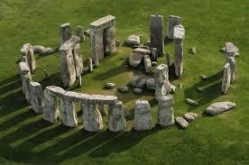
Stonehenge

Slide 7
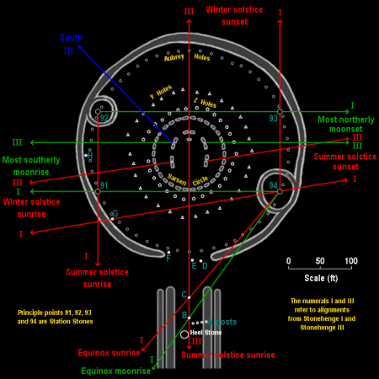
Stonehenge and Astronomical events

Slide 8
The Druids
The druids were a priestly cast that were responsible for many roles in the areas where they were allowed. They were priests, doctors, lawyers, astronomers, historians, and negotiators. They rose to significance around 200 BCE.
They did engage in human sacrifice, and there is significant archaeological evidence to support this.
They had nothing to do with the henges which were built centuries earlier.
The Bog people in Denmark are some of the sacrifices, and another method of sacrificing was the wicker man.

Slide 9
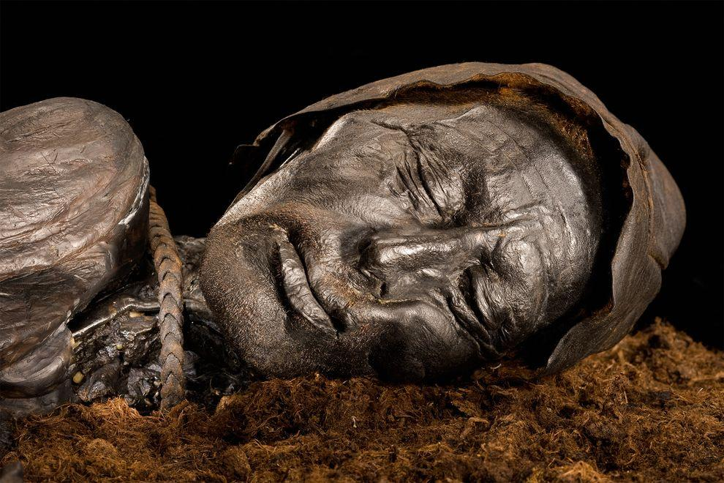
The Bog people
The bog people were
a group of
mummified people
found mostly in the
peat bogs in
Denmark and
Northern Europe.
Most were found nude and showed signs of being stabbed, bludgeoned and/or strangled. They were placed carefully in the bog, showing some significance to the death.

Slide 10
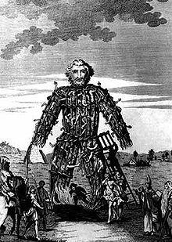
The Wicker Man
The Wicker man is a tall thin effigy of a man, made of sticks about two to
three times the height of a man.
The sacrifice was placed inside
and the whole set afire.

Slide 11
The Gaels
These were iron age people, and their origin is unsure. Some believe they were Scandinavian, while others believe they were Germanic, and others say they have been always identified as Irish as far back as 7000 BCE.
They settled Ireland, Scotland, Wales and the Isle of Mann, and have been known as a highland tribe. In fact, there were Gaelic kingdoms that united these three areas, but they never invaded the lowlands in South eastern England.

Slide 12
Gaels
The Gaels were primarily Irish, although a group, later called the Picts did move to Scotland, but were eventually supplanted by later Irish Settlers. The Gaels also occupied Wales and the Isle of Mann.

Slide 13
Gaelic religion
The Gaels were unusual in that they believed that the individual could contact the gods without a “priest class” such as the druids. They saw magic as common, a part of the everyday. In fact, there were incantations that were sung in simple everyday tasks such as weeding or stoking a fire. They did NOT believe in human sacrifice, so the connection between the Gaels and druids is a common misconception.

Slide 14
Gaelic Feminism
The Gaels gave women equal status as men up to the Romans and Christians. This is highly unusual for paleolithic people.
The records show that women had the rights to own and disburse property, inherit property and have skills, as well own and use weapons on the field of battle. They also had rights in the construction of their marriage contract, as well as complete authority within their homes. A woman’s authority was in the hearth and the man’s on the land.

Slide 15
Gaelic Society
Gaelic society was based on the clan, with a comprehensive set of laws covering everything from blood pricing to contract law.
There were two key concepts that ran through Gaelic society: hospitality and the importance of the poets.
Hospitality was demonstrated by providing guests with the very best, and a responsibility to protect these guests even to the death of the host.
The poets/bards in Gaelic society were a special class in law and severe penalties were imposed if a poet were harmed or even threatened.

Slide 16
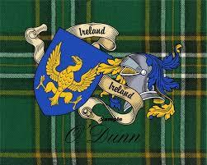
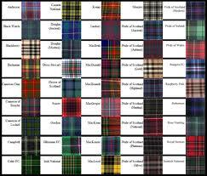
The Tartan
Every clan had a unique color combination that was worn by all the members. It was a sort of flag and uniform at the same time.

Slide 17
Gaelic world view
The Gaels possessed a unique world view for an iron age people. They saw life on Earth as part of an unending journey.They expressed this view in symbols, specifically what has become known as the Celtic knot.
If one traces the strand or strands,
they will eventually return to
their starting point.

Slide 18
The Fair, Festival and Banquet
The fair was held for special events and participation by all was mandatory. Not to celebrate the life one had been given was considered an affront to everyone, including the gods. It was also a time of one would hear the news of great deeds and the world.
The festival was a unique time in Gaelic culture. It was a time no weapon could be raised, no debts collected, and no arguments.
There were four traditional festivals held during solar events.
To hold a good banquet was a matter of much prestige. It was considered good
form to invite the 'aes dana' (people of the arts - bards, musicians, smiths,
etc. ). Songs were sung, legends retold, and clan genealogies recited.

Slide 19
An American festival
Many countries have a festival at the end of the harvest and marking the start of winter. The Gaels also had a festival. The Festival of Samhain.
It was a time when cattle were slaughtered for the winter, and also a time when the faerie folk could enter our world, and the spirits of the dead could revisit their former lives.
It was always important to appease the faerie folk and keep a place for the deceased at the table. It was also a time where travel was dangerous, so a disguise like a faerie or the deceased was needed to travel safely.

Slide 20
A Gaelic holiday.
Any idea what holiday the festival of Samhain became?

Slide 21
A hint…..

Slide 22
The Gauls
The Gauls were a brother tribe to the Gaels, but lived on continental Europe, centered in France.
The Gauls were not like the Gaels, in that the druids were dominated by the druid priestly cast.
They were also animistic, believing that natural features such as rivers, mountains were semi-divine.

Slide 23
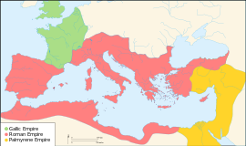
The Gauls 271 CE

Slide 24
The Romans
In the first century, the people of Britain were confronted by a new threat: the Roman Empire.

