Slide 1
The Vikings

Slide 2
Do Now
KWL what you know about the vikings.

Slide 3
Classwork
Classwork: Label 5 pages:
1-World View
2-Religion
3- Feminism
4-Warrior Code
5- Racism
Fill in each page with the appropriate notes, and as we read you’ll add line numbers from Beowulf.

Slide 4
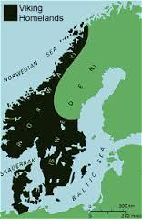
Who are the Vikings?
The Vikings were not one people
but several different Germanic
tribes. However, they shared
beliefs, culture and religion.
They were from Scandanavia
which includes Norway, Sweden
and Denmark.

Slide 5
when were the VIkings
The earliest recorded attacks by Vikings in Britain occurred in 709 CE, and the end of the Viking era is considered to be in 1066 with the Norman conquest of Britain.

Slide 6
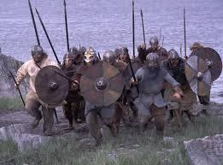
The Viking Warrior
Traditionally armed with longsword, axe
or spear. They wore leather, banded,
scale or chain armor. They usually had a
circular shield, and steel helmet (NO
HORNS).
Important fact: The quality of the weapons varied from maker to maker, unlike the standard Roman weapons.

Slide 7
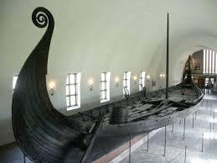
The Viking Longboat
The Viking Longboat was meant to
be an open ocean vessel, long and wide, symmetrical at both ends so a quick reversal was possible, about a meter on average draft, and carried between 80 and 280 men, depending on the size of the vessel.

Slide 8
The longboat
The construction of the longboat allowed it to travel quickly across the ocean, up shallow rivers, and land on any beach.
They were either rowed and/or sailed, depending on weather or urgency.
It allowed the vikings to travel to Africa, the Middle East, and North America.

Slide 9
The longboat
The vikings were mostly isolated raiders of a few ships but in the 800’s at the peak of the viking power, fleets of over 600 would form and attack major cities.

Slide 10
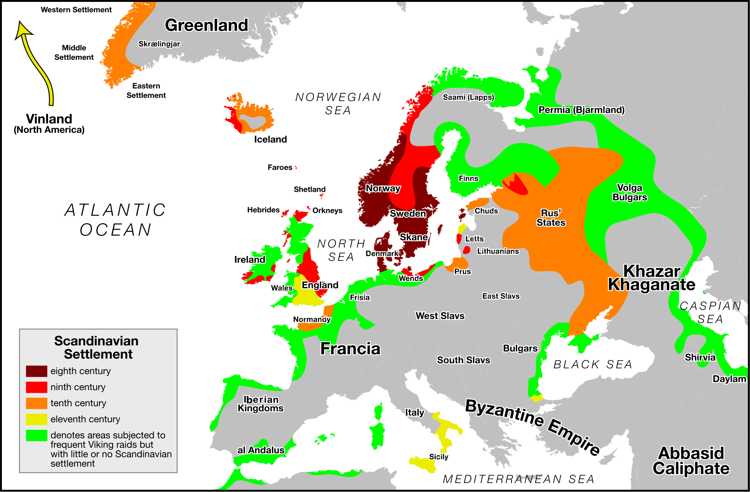

Slide 11
Viking society
Viking society was divided into 3 classes: thralls. karls, jarls. They were respectively: slaves, freemen without status, and nobles.
The vikings were identified to each other as _______, son of _______, son of ____., so genealogy mattered.
Slaves were an important part of viking culture as they conducted most of the daily chores and operations of viking society. This allowed the other two classes to focus on the skills of war.
This culture reflects a similar one seen where?

Slide 12
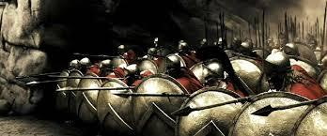
hint

Slide 13
Viking feminism
Vikings perceived women in one of two ways: one, the meek, mild, subservient yet wise woman who would always lead her man to the right decision, or two, the warrior woman, as ruthless and sexually overt as any man.

Slide 14
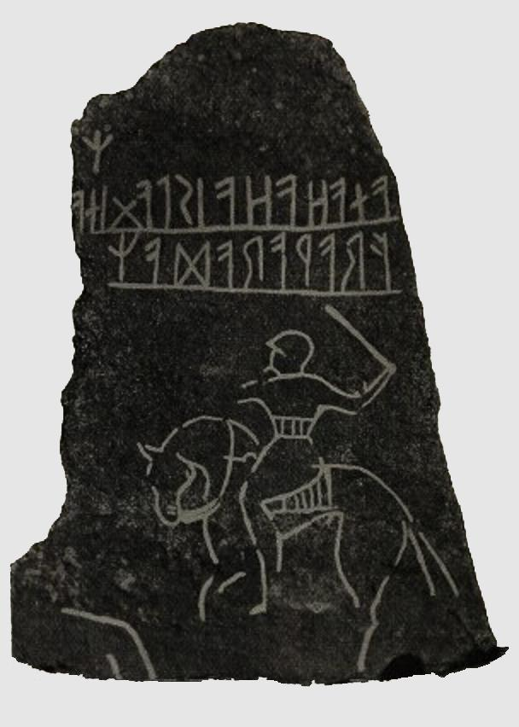
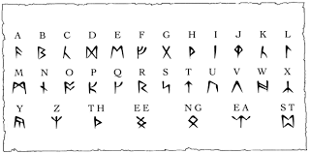
Viking writing
Most vikings were literate, and
could read and write runescript to
some degree.
An early runestone: the Möjbro Runestone from Hagby (first placed near Möjebro), Uppland, Sweden. As with other early runic inscriptions, (e.g. Kylver Stonefrom about 300 - 400 CE) this is written from right to left, while later Runestones were written from left to right.[citation needed] The text is "Frawaradaz anahaha is laginaz"

Slide 15
Viking World View
The vikings held an even darker view of the world than the Anglo-Saxons. They were convinced that nature and the world were trying to exterminate humanity. They also believed in magic and charms.

Slide 16
Viking religion
The vikings worshipped a set of Gods, led by Odin. In many ways there are corollaries to the Greek deities. However, these deities were even more capricious than the Greek gods, and would rarely help a human. The best a warrior could hope for was to die in battle and then be taken, if brave enough, to Valhalla.
The Norse gods lived in Asgard, a separate plane than Earth, which was Midgard, and between Asgard and Jotunheim, inhabited by frost giants. These giants wish to destroy Asgard and the tree of life,Yggdrasil.

Slide 17
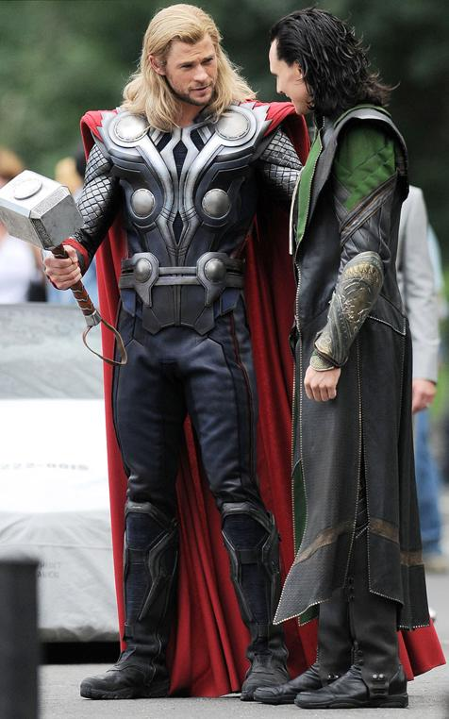
VIking Gods
The Norse gods or Aesir, were led by
Odin, and his wife Frigg or Friga. The
most commonly known gods are Thor,
god of thunder and lightning who
wielded Mjolnir, a magical hammer,
and his brother Loki, god of mischief.
There were many other as well.

Slide 18
The Viking Warrior Code
The viking warrior code is similar to that of the warrior code of Sparta and Greece. The greatest way to die was in battle (and in Sparta the only way a man was given a grave), and if brave enough go to heaven.
The ideas of fame and glory were also a way to ensure your memory being retained in the culture, so in both if there is a monster, the hero must face it.

Slide 19
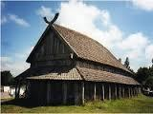
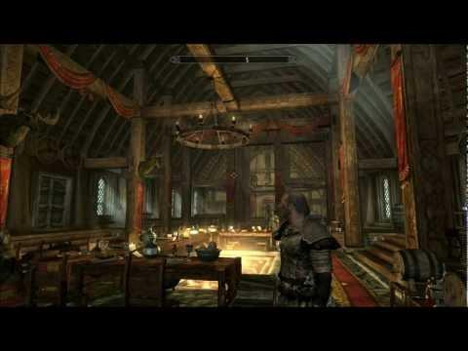
The Mead hall
The mead hall was the center of viking culture. it was here honors were given and where a karl could become a jarl. It was a place where feasting, drinking, singing, and other amusements occurred. It was also a place of
fellowship, where warriors could
meet with their peers, and the
hostile world was kept outside. It
was also the place where bards sang
the stories of the great heroes.

Slide 20
The Vikings and Britain
A close and easy place to raid for the vikings was Britain. Most of the country is within a single day’s march from the sea, and there was no powerful navy or government to stop them.

Slide 21
The vikings and Christianity: Raiding
The vikings soon discovered that Christian churches and monasteries were figuratively a gold mine. Since communication with Rome had broken down, the churches in Britain had been holding on to all the money given as offerings or tithes, in some cases for a century or more.

Slide 22
Raiding pt 2
Monasteries were exceptionally vulnerable, as they were secluded, relatively unguarded, and generally had full coffers.
Over the 200 years of Viking raids the vikings effectively destroyed the monastic aspect of Britain.

Slide 23
Christianity and the Vikings: impact
The influence of Christianity on the vikings is difficult to discern. Many viking tribes never fully converted, and some did wholesale.
However, most merely replaced capricious Norse gods with capricious Christian God. They saw the devil’s domination of the Earth as confirmation of their previous belief that nature was trying to kill humanity.

Slide 24
The Vikings and Britain
The viking raiders brought home the departure and security of the Roman Empire. This provided impetus for someone to unify Britain, or at least England. This plays out in many nations and we will see what happens in British literature to reflect this next.

Slide 25
Homework
Go online and onto my web site and read The Beowulf pre-read with The Seafarer (link provided).
Also read The Wrath of Grendel in Beowulf 1 (provided as a pdf).
Reminder: NOTE lines that refer to one of the 5 categories we started with.

